Slide 1

Vidyalankar Polytechnic
Program:Information Technology

Slide 2
V-Practical
Shubham Pote 18202A0002
Yash Hajare 18202A0024
Sanket More 18202A0025
Prasad Kashid 18202A0030
Guided By-
Prerana Jalgaonkar

Slide 3
Problem Statement
In this Pandemic, students are not able to attend their college or school physically. College/Universities are working online for their students. Students have to perform practical to gain practical insight of a concepts. Practical is an essential part of study to get information about the subject.
We are developing a web application named as V-Practical, which helps students and teachers to work online. V-Practical will help students to submit their practical online. Students can upload their practical and submit it to teacher using V-Practical application. The V-Practical is mainly designed for the students and teachers for online practical submission.

Slide 4
Abstract
Online learning is when you take courses online instead of in a physical classroom.
Online learning is an essential part of life nowadays.
In this pandemic colleges, schools are working online for there students.
Students also have to perform there practical online.
This is the unique way for conducting practical online.
With online Learning students can do the exam online, in their own time, with their own device, regardless of where they live.

Slide 5
Introduction
Our Project Title is V-Practical . A system based on formalized submission of practical and assignment but with the help of electronic resources is known as V-Practical.
While submission can be based in or out of the classrooms, the use of computers and the Internet forms the major component of Submitting resource V-Practical.
However, with the rapid progress in technology and the advancement in systems, it is now embraced by the masses.
Practical submission can also be termed as a network enabled transfer of skills and knowledge, and the delivery of education is made to a large number of recipients at the same or different times.

Slide 6
Algorithm
Step 1: Start.
Step 2: Teacher logs into the System.
Step 3: Teacher adds practical.
Step 4: Student logs into the system.
Step 5: Student solves practical
Step 6: Student upload output and code.
Step 7: Data submitted.
Step 8: Data send to teacher.
Step 9: Stop.

Slide 7
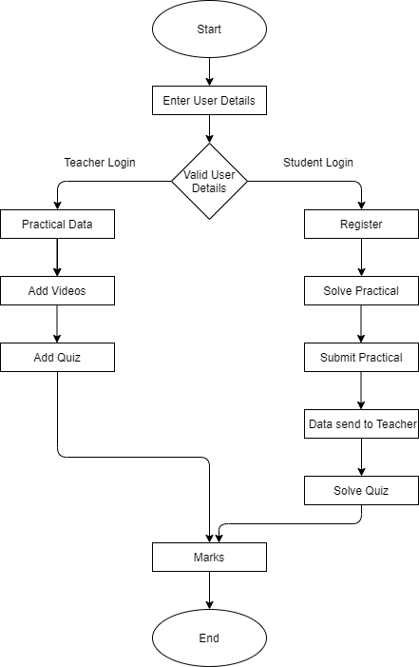
Flow Diagram

Slide 8
Pros and Cons
Pros
Cons
Lack of social interaction.
If someone does not have access to internet then our application will not work.
Online Student feedback is limited.
Lack of communication skills.
It is an easy way to conduct practical online.
It will save time because it as easy way to interact online.
Simple UI and user friendly.
You can easily submit resources in several varying formats.
As you have access to the internet 24*7, you can perform practical anywhere and anytime.

Slide 9
Applications
Help to submit from anywhere at anytime.
It is interactive between teacher and students.
You can download practical uploaded by teacher.
Some reference link about concept will be provide for more information to the student.

Slide 10
Conclusion
A practical submission module is very essential for college/university. This proposed system is a web based application that provides facility for maintaining the practical data. This will help students to complete there practical and submit it online.

